Slide 1

Dr. Ammar Haider
Assistant Professor
School of Computing
CS3002 Information Security
Access Control

Slide 2
Access Control
Access control implements a security policy that specifies who may have access to each specific system resource, and the type of access that is permitted in each instance.
It is the process of ensuring authenticated users have access to the resources they are authorized to use and don’t have access to any other resources.
In a broad sense, all of computer security is concerned with access control.
Notes:
Two definitions of access control are useful in understanding its scope.
1. NISTIR 7298 (Glossary of Key Information Security Terms , May 2013), defines access control as the process of granting or denying specific requests to: (1) obtain and use information and related information processing services; and (2) enter specific physical facilities.

Slide 3
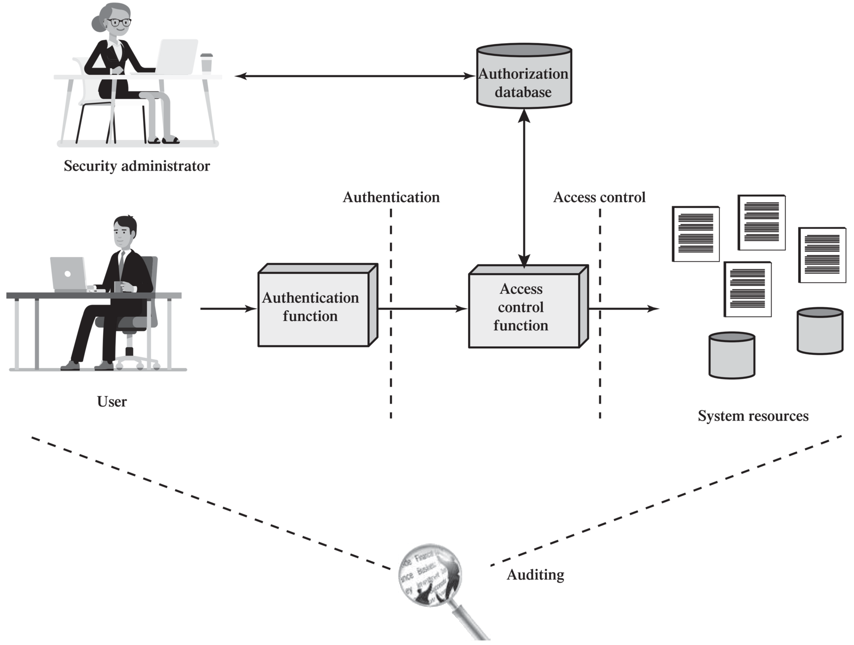
Context of Access Control
Notes:
Figure 4.1 shows a broader context of access control. In addition to access control, this context involves the following entities and functions:
• Authentication: Verification that the credentials of a user or other system entity are valid.
• Authorization: The granting of a right or permission to a system entity to access a system resource. This function determines who is trusted for a given purpose.
• Audit: An independent review and examination of system records and activities in order to test for adequacy of system controls, to ensure compliance with established policy and operational procedures, to detect breaches in security, and to recommend any indicated changes in control, policy and procedures.
An access control mechanism mediates between a user (or a process executing on behalf of a user) and system resources, such as applications, operating systems, firewalls, routers, files, and databases. The system must first authenticate an entity seeking access. Typically, the authentication function determines whether the user is permitted to access the system at all. Then the access control function determines
if the specific requested access by this user is permitted. A security administrator maintains an authorization database that specifies what type of access to which resources is allowed for this user. The access control function consults this database to determine whether to grant access. An auditing function monitors and keeps a record of user accesses to system resources.
In the simple model of Figure 4.1, the access control function is shown as a single logical module. In practice, a number of components may cooperatively share the access control function. All operating systems have at least a rudimentary, and in many cases a quite robust, access control component. Add-on security packages can supplement the native access control capabilities of the OS. Particular applications or utilities, such as a database management system, also incorporate access control functions. External devices, such as firewalls, can also provide access control services.
The security administrator creates and maintains the authorization database. The user accesses the systems resources after being authenticated by the authentication function. The access is controlled via access control function. A data exchange occurs between access control function and authorization database. Audit consists of an independent review and examination of system records and activities.

Slide 4
Context of Access Control
Verification of credentials of a user (or process)
Notes:
Figure 4.1 shows a broader context of access control. In addition to access control, this context involves the following entities and functions:
• Authentication: Verification that the credentials of a user or other system entity are valid.
• Authorization: The granting of a right or permission to a system entity to access a system resource. This function determines who is trusted for a given purpose.
• Audit: An independent review and examination of system records and activities in order to test for adequacy of system controls, to ensure compliance with established policy and operational procedures, to detect breaches in security, and to recommend any indicated changes in control, policy and procedures.
An access control mechanism mediates between a user (or a process executing on behalf of a user) and system resources, such as applications, operating systems, firewalls, routers, files, and databases. The system must first authenticate an entity seeking access. Typically, the authentication function determines whether the user is permitted to access the system at all. Then the access control function determines
if the specific requested access by this user is permitted. A security administrator maintains an authorization database that specifies what type of access to which resources is allowed for this user. The access control function consults this database to determine whether to grant access. An auditing function monitors and keeps a record of user accesses to system resources.
In the simple model of Figure 4.1, the access control function is shown as a single logical module. In practice, a number of components may cooperatively share the access control function. All operating systems have at least a rudimentary, and in many cases a quite robust, access control component. Add-on security packages can supplement the native access control capabilities of the OS. Particular applications or utilities, such as a database management system, also incorporate access control functions. External devices, such as firewalls, can also provide access control services.
The security administrator creates and maintains the authorization database. The user accesses the systems resources after being authenticated by the authentication function. The access is controlled via access control function. A data exchange occurs between access control function and authorization database. Audit consists of an independent review and examination of system records and activities.

Slide 5
Context of Access Control
What permissions a user has for each resource
Notes:
Figure 4.1 shows a broader context of access control. In addition to access control, this context involves the following entities and functions:
• Authentication: Verification that the credentials of a user or other system entity are valid.
• Authorization: The granting of a right or permission to a system entity to access a system resource. This function determines who is trusted for a given purpose.
• Audit: An independent review and examination of system records and activities in order to test for adequacy of system controls, to ensure compliance with established policy and operational procedures, to detect breaches in security, and to recommend any indicated changes in control, policy and procedures.
An access control mechanism mediates between a user (or a process executing on behalf of a user) and system resources, such as applications, operating systems, firewalls, routers, files, and databases. The system must first authenticate an entity seeking access. Typically, the authentication function determines whether the user is permitted to access the system at all. Then the access control function determines
if the specific requested access by this user is permitted. A security administrator maintains an authorization database that specifies what type of access to which resources is allowed for this user. The access control function consults this database to determine whether to grant access. An auditing function monitors and keeps a record of user accesses to system resources.
In the simple model of Figure 4.1, the access control function is shown as a single logical module. In practice, a number of components may cooperatively share the access control function. All operating systems have at least a rudimentary, and in many cases a quite robust, access control component. Add-on security packages can supplement the native access control capabilities of the OS. Particular applications or utilities, such as a database management system, also incorporate access control functions. External devices, such as firewalls, can also provide access control services.
The security administrator creates and maintains the authorization database. The user accesses the systems resources after being authenticated by the authentication function. The access is controlled via access control function. A data exchange occurs between access control function and authorization database. Audit consists of an independent review and examination of system records and activities.

Slide 6
Context of Access Control
Enforcement of all authorization rules
Notes:
Figure 4.1 shows a broader context of access control. In addition to access control, this context involves the following entities and functions:
• Authentication: Verification that the credentials of a user or other system entity are valid.
• Authorization: The granting of a right or permission to a system entity to access a system resource. This function determines who is trusted for a given purpose.
• Audit: An independent review and examination of system records and activities in order to test for adequacy of system controls, to ensure compliance with established policy and operational procedures, to detect breaches in security, and to recommend any indicated changes in control, policy and procedures.
An access control mechanism mediates between a user (or a process executing on behalf of a user) and system resources, such as applications, operating systems, firewalls, routers, files, and databases. The system must first authenticate an entity seeking access. Typically, the authentication function determines whether the user is permitted to access the system at all. Then the access control function determines
if the specific requested access by this user is permitted. A security administrator maintains an authorization database that specifies what type of access to which resources is allowed for this user. The access control function consults this database to determine whether to grant access. An auditing function monitors and keeps a record of user accesses to system resources.
In the simple model of Figure 4.1, the access control function is shown as a single logical module. In practice, a number of components may cooperatively share the access control function. All operating systems have at least a rudimentary, and in many cases a quite robust, access control component. Add-on security packages can supplement the native access control capabilities of the OS. Particular applications or utilities, such as a database management system, also incorporate access control functions. External devices, such as firewalls, can also provide access control services.
The security administrator creates and maintains the authorization database. The user accesses the systems resources after being authenticated by the authentication function. The access is controlled via access control function. A data exchange occurs between access control function and authorization database. Audit consists of an independent review and examination of system records and activities.

Slide 7
Context of Access Control
An independent review and examination of system records and activities to ensure compliance with the policy.
Notes:
Figure 4.1 shows a broader context of access control. In addition to access control, this context involves the following entities and functions:
• Authentication: Verification that the credentials of a user or other system entity are valid.
• Authorization: The granting of a right or permission to a system entity to access a system resource. This function determines who is trusted for a given purpose.
• Audit: An independent review and examination of system records and activities in order to test for adequacy of system controls, to ensure compliance with established policy and operational procedures, to detect breaches in security, and to recommend any indicated changes in control, policy and procedures.
An access control mechanism mediates between a user (or a process executing on behalf of a user) and system resources, such as applications, operating systems, firewalls, routers, files, and databases. The system must first authenticate an entity seeking access. Typically, the authentication function determines whether the user is permitted to access the system at all. Then the access control function determines
if the specific requested access by this user is permitted. A security administrator maintains an authorization database that specifies what type of access to which resources is allowed for this user. The access control function consults this database to determine whether to grant access. An auditing function monitors and keeps a record of user accesses to system resources.
In the simple model of Figure 4.1, the access control function is shown as a single logical module. In practice, a number of components may cooperatively share the access control function. All operating systems have at least a rudimentary, and in many cases a quite robust, access control component. Add-on security packages can supplement the native access control capabilities of the OS. Particular applications or utilities, such as a database management system, also incorporate access control functions. External devices, such as firewalls, can also provide access control services.
The security administrator creates and maintains the authorization database. The user accesses the systems resources after being authenticated by the authentication function. The access is controlled via access control function. A data exchange occurs between access control function and authorization database. Audit consists of an independent review and examination of system records and activities.

Slide 8
Context of Access Control
Authentication is a less frequent activity (one login per session)
Notes:
Figure 4.1 shows a broader context of access control. In addition to access control, this context involves the following entities and functions:
• Authentication: Verification that the credentials of a user or other system entity are valid.
• Authorization: The granting of a right or permission to a system entity to access a system resource. This function determines who is trusted for a given purpose.
• Audit: An independent review and examination of system records and activities in order to test for adequacy of system controls, to ensure compliance with established policy and operational procedures, to detect breaches in security, and to recommend any indicated changes in control, policy and procedures.
An access control mechanism mediates between a user (or a process executing on behalf of a user) and system resources, such as applications, operating systems, firewalls, routers, files, and databases. The system must first authenticate an entity seeking access. Typically, the authentication function determines whether the user is permitted to access the system at all. Then the access control function determines
if the specific requested access by this user is permitted. A security administrator maintains an authorization database that specifies what type of access to which resources is allowed for this user. The access control function consults this database to determine whether to grant access. An auditing function monitors and keeps a record of user accesses to system resources.
In the simple model of Figure 4.1, the access control function is shown as a single logical module. In practice, a number of components may cooperatively share the access control function. All operating systems have at least a rudimentary, and in many cases a quite robust, access control component. Add-on security packages can supplement the native access control capabilities of the OS. Particular applications or utilities, such as a database management system, also incorporate access control functions. External devices, such as firewalls, can also provide access control services.
The security administrator creates and maintains the authorization database. The user accesses the systems resources after being authenticated by the authentication function. The access is controlled via access control function. A data exchange occurs between access control function and authorization database. Audit consists of an independent review and examination of system records and activities.

Slide 9
Context of Access Control
But access control mechanism is continuous. It mediates between a user (or a process) and system resources, such as applications, operating systems, routers, files, and databases.
Notes:
Figure 4.1 shows a broader context of access control. In addition to access control, this context involves the following entities and functions:
• Authentication: Verification that the credentials of a user or other system entity are valid.
• Authorization: The granting of a right or permission to a system entity to access a system resource. This function determines who is trusted for a given purpose.
• Audit: An independent review and examination of system records and activities in order to test for adequacy of system controls, to ensure compliance with established policy and operational procedures, to detect breaches in security, and to recommend any indicated changes in control, policy and procedures.
An access control mechanism mediates between a user (or a process executing on behalf of a user) and system resources, such as applications, operating systems, firewalls, routers, files, and databases. The system must first authenticate an entity seeking access. Typically, the authentication function determines whether the user is permitted to access the system at all. Then the access control function determines
if the specific requested access by this user is permitted. A security administrator maintains an authorization database that specifies what type of access to which resources is allowed for this user. The access control function consults this database to determine whether to grant access. An auditing function monitors and keeps a record of user accesses to system resources.
In the simple model of Figure 4.1, the access control function is shown as a single logical module. In practice, a number of components may cooperatively share the access control function. All operating systems have at least a rudimentary, and in many cases a quite robust, access control component. Add-on security packages can supplement the native access control capabilities of the OS. Particular applications or utilities, such as a database management system, also incorporate access control functions. External devices, such as firewalls, can also provide access control services.
The security administrator creates and maintains the authorization database. The user accesses the systems resources after being authenticated by the authentication function. The access is controlled via access control function. A data exchange occurs between access control function and authorization database. Audit consists of an independent review and examination of system records and activities.

Slide 10
Terminology: Subject
Subject is an entity capable of accessing objects.
Three classes
Owner
Group
World
A user might be owner of a resource, or might be included in the group who has higher access to resource. If neither is true, that user is said to be included in (rest of the) world.
Notes:
The basic elements of access control are: subject, object, and access right.
A subject is an entity capable of accessing objects. Generally, the concept of subject equates with that of process. Any user or application actually gains access to an object by means of a process that represents that user or application. The process takes on the attributes of the user, such as access rights.
A subject is typically held accountable for the actions they have initiated, and an audit trail may be used to record the association of a subject with security relevant actions performed on an object by the subject.
Basic access control systems typically define three classes of subject, with different access rights for each class:
• Owner: This may be the creator of a resource, such as a file. For system resources, ownership may belong to a system administrator. For project resources, a project administrator or leader may be assigned ownership.
• Group: In addition to the privileges assigned to an owner, a named group of users may also be granted access rights, such that membership in the group is sufficient to exercise these access rights. In most schemes, a user may belong to multiple groups.
• World: The least amount of access is granted to users who are able to access the system but are not included in the categories owner and group for this resource.
An object is a resource to which access is controlled. In general, an object is an entity used to contain and/or receive information. Examples include records, blocks, pages, segments, files, portions of files, directories, directory trees, mailboxes, messages, and programs. Some access control systems also encompass, bits, bytes, words, processors, communication ports, clocks, and network nodes.
The number and types of objects to be protected by an access control system depends on the environment in which access control operates and the desired tradeoff between security on the one hand and complexity, processing burden, and ease of use on the other hand.
An access right describes the way in which a subject may access an object. Access rights could include the following:
• Read: User may view information in a system resource (e.g., a file, selected records in a file, selected fields within a record, or some combination). Read access includes the ability to copy or print.
• Write: User may add, modify, or delete data in system resource (e.g., files, records, programs). Write access includes read access.
• Execute: User may execute specified programs.
• Delete: User may delete certain system resources, such as files or records.
• Create: User may create new files, records, or fields.
• Search: User may list the files in a directory or otherwise search the directory.

Slide 11
Terminology: Object
An object is a resource to which access is controlled. Examples include:
Records
Files, portion of files
Directories, directory-trees
Messages
Programs
The number and types of objects to be protected depends on the system environment and the desired tradeoff between security on one hand, and complexity, processing burden, and ease of use on the other hand.
Processors
Communication ports
Network nodes
Memory segments
Bits, bytes, words
Notes:
The basic elements of access control are: subject, object, and access right.
A subject is an entity capable of accessing objects. Generally, the concept of subject equates with that of process. Any user or application actually gains access to an object by means of a process that represents that user or application. The process takes on the attributes of the user, such as access rights.
A subject is typically held accountable for the actions they have initiated, and an audit trail may be used to record the association of a subject with security relevant actions performed on an object by the subject.
Basic access control systems typically define three classes of subject, with different access rights for each class:
• Owner: This may be the creator of a resource, such as a file. For system resources, ownership may belong to a system administrator. For project resources, a project administrator or leader may be assigned ownership.
• Group: In addition to the privileges assigned to an owner, a named group of users may also be granted access rights, such that membership in the group is sufficient to exercise these access rights. In most schemes, a user may belong to multiple groups.
• World: The least amount of access is granted to users who are able to access the system but are not included in the categories owner and group for this resource.
An object is a resource to which access is controlled. In general, an object is an entity used to contain and/or receive information. Examples include records, blocks, pages, segments, files, portions of files, directories, directory trees, mailboxes, messages, and programs. Some access control systems also encompass, bits, bytes, words, processors, communication ports, clocks, and network nodes.
The number and types of objects to be protected by an access control system depends on the environment in which access control operates and the desired tradeoff between security on the one hand and complexity, processing burden, and ease of use on the other hand.
An access right describes the way in which a subject may access an object. Access rights could include the following:
• Read: User may view information in a system resource (e.g., a file, selected records in a file, selected fields within a record, or some combination). Read access includes the ability to copy or print.
• Write: User may add, modify, or delete data in system resource (e.g., files, records, programs). Write access includes read access.
• Execute: User may execute specified programs.
• Delete: User may delete certain system resources, such as files or records.
• Create: User may create new files, records, or fields.
• Search: User may list the files in a directory or otherwise search the directory.

Slide 12
Terminology: Access Right
An access right describes the way in which a subject may access an object
Could include:
Read: view, copy, print
Write: add, modify, delete. Read access is included!
Execute
Delete
Create
Search
Notes:
The basic elements of access control are: subject, object, and access right.
A subject is an entity capable of accessing objects. Generally, the concept of subject equates with that of process. Any user or application actually gains access to an object by means of a process that represents that user or application. The process takes on the attributes of the user, such as access rights.
A subject is typically held accountable for the actions they have initiated, and an audit trail may be used to record the association of a subject with security relevant actions performed on an object by the subject.
Basic access control systems typically define three classes of subject, with different access rights for each class:
• Owner: This may be the creator of a resource, such as a file. For system resources, ownership may belong to a system administrator. For project resources, a project administrator or leader may be assigned ownership.
• Group: In addition to the privileges assigned to an owner, a named group of users may also be granted access rights, such that membership in the group is sufficient to exercise these access rights. In most schemes, a user may belong to multiple groups.
• World: The least amount of access is granted to users who are able to access the system but are not included in the categories owner and group for this resource.
An object is a resource to which access is controlled. In general, an object is an entity used to contain and/or receive information. Examples include records, blocks, pages, segments, files, portions of files, directories, directory trees, mailboxes, messages, and programs. Some access control systems also encompass, bits, bytes, words, processors, communication ports, clocks, and network nodes.
The number and types of objects to be protected by an access control system depends on the environment in which access control operates and the desired tradeoff between security on the one hand and complexity, processing burden, and ease of use on the other hand.
An access right describes the way in which a subject may access an object. Access rights could include the following:
• Read: User may view information in a system resource (e.g., a file, selected records in a file, selected fields within a record, or some combination). Read access includes the ability to copy or print.
• Write: User may add, modify, or delete data in system resource (e.g., files, records, programs). Write access includes read access.
• Execute: User may execute specified programs.
• Delete: User may delete certain system resources, such as files or records.
• Create: User may create new files, records, or fields.
• Search: User may list the files in a directory or otherwise search the directory.

Slide 13
Access Control Models
An access control model (i.e. methodology) dictates what types of access are permitted, under what circumstances, and by whom.
Some well-known ones are:
Discretionary Access Control (DAC)
Non-discretionary
Mandatory Access Control (MAC)
Role-Based Access Control (RBAC)
Rule-based access control
Attribute-Based Access Control (ABAC)
Risk-based access control
centralized administration
Notes:
An access control policy, which can be embodied in an authorization database, dictates what types of access are permitted, under what circumstances, and by whom. Access control policies are generally grouped into the following categories:
• Discretionary access control (DAC): Controls access based on the identity of the requestor and on access rules (authorizations) stating what requestors are (or are not) allowed to do. This policy is termed discretionary because an entity might have access rights that permit the entity, by its own volition, to enable another entity to access some resource.
• Mandatory access control (MAC): Controls access based on comparing security labels (which indicate how sensitive or critical system resources are) with security clearances (which indicate system entities are eligible to access certain resources). This policy is termed mandatory because an entity that has clearance to access a resource may not, just by its own volition, enable another entity to access that resource.
• Role-based access control (RBAC): Controls access based on the roles that users have within the system and on rules stating what accesses are allowed to users in given roles.
• Attribute-based access control (ABAC): Controls access based on attributes of the user, the resource to be accessed, and current environmental conditions.
DAC is the traditional method of implementing access control, and is examined in Sections 4.3 and 4.4. MAC is a concept that evolved out of requirements for military information security and is best covered in the context of trusted systems, which we deal with in Chapter 27. Both RBAC and ABAC have become increasingly popular, and are examined in Sections 4.5 and 4.6, respectively.
These four policies are not mutually exclusive. An access control mechanism can employ two or even all three of these policies to cover different classes of system resources.

Slide 14
Discretionary Access Control (DAC)
Controls access based on the identity of the requestor and on access rules (authorizations) stating what requestors are (or are not) allowed to do
An entity might have access rights that permit it to grant another entity access to some resource. That’s why this policy is called discretionary.
In most implementations, granting access rights is at the discretion of the owner.

Slide 15
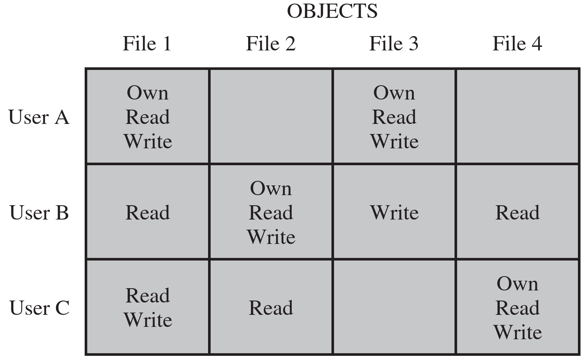
DAC: Access Control Matrix
In general, all authorization rules of a system can be put together in a matrix format
Objects
Subjects
Notes:
Figure 4.2a, based on a figure in [SAND94], is a simple example of an access matrix. Thus, user A owns files 1 and 3 and has read and write access rights to those files. User B has read access rights to file 1, and so on.
The columns have the following headings from left to right. Subjects, Objects, file 1, Objects File 2, Objects, file 3, Objects, file 4, . The row entries are as follows. Row 1. User A, own read write, Blank, Own, read, write, Blank. Row 2. User B, Read, Own, read, write, Write, Read. Row 3. User C, Read write, Read, Blank, Own read write.

Slide 16
DAC: Access Control Matrix
In general, all authorization rules of a system can be put together in a matrix format
Objects
Here, subjects could be individual users or groups of users
Subjects
Notes:
Figure 4.2a, based on a figure in [SAND94], is a simple example of an access matrix. Thus, user A owns files 1 and 3 and has read and write access rights to those files. User B has read access rights to file 1, and so on.
The columns have the following headings from left to right. Subjects, Objects, file 1, Objects File 2, Objects, file 3, Objects, file 4, . The row entries are as follows. Row 1. User A, own read write, Blank, Own, read, write, Blank. Row 2. User B, Read, Own, read, write, Write, Read. Row 3. User C, Read write, Read, Blank, Own read write.

Slide 17
Access Control Lists (ACL)
Columns in the access matrix represent ACL for each object: a list of users with their permitted access rights.
Objects
Subjects
Notes:
Figure 4.2a, based on a figure in [SAND94], is a simple example of an access matrix. Thus, user A owns files 1 and 3 and has read and write access rights to those files. User B has read access rights to file 1, and so on.
The columns have the following headings from left to right. Subjects, Objects, file 1, Objects File 2, Objects, file 3, Objects, file 4, . The row entries are as follows. Row 1. User A, own read write, Blank, Own, read, write, Blank. Row 2. User B, Read, Own, read, write, Write, Read. Row 3. User C, Read write, Read, Blank, Own read write.

Slide 18
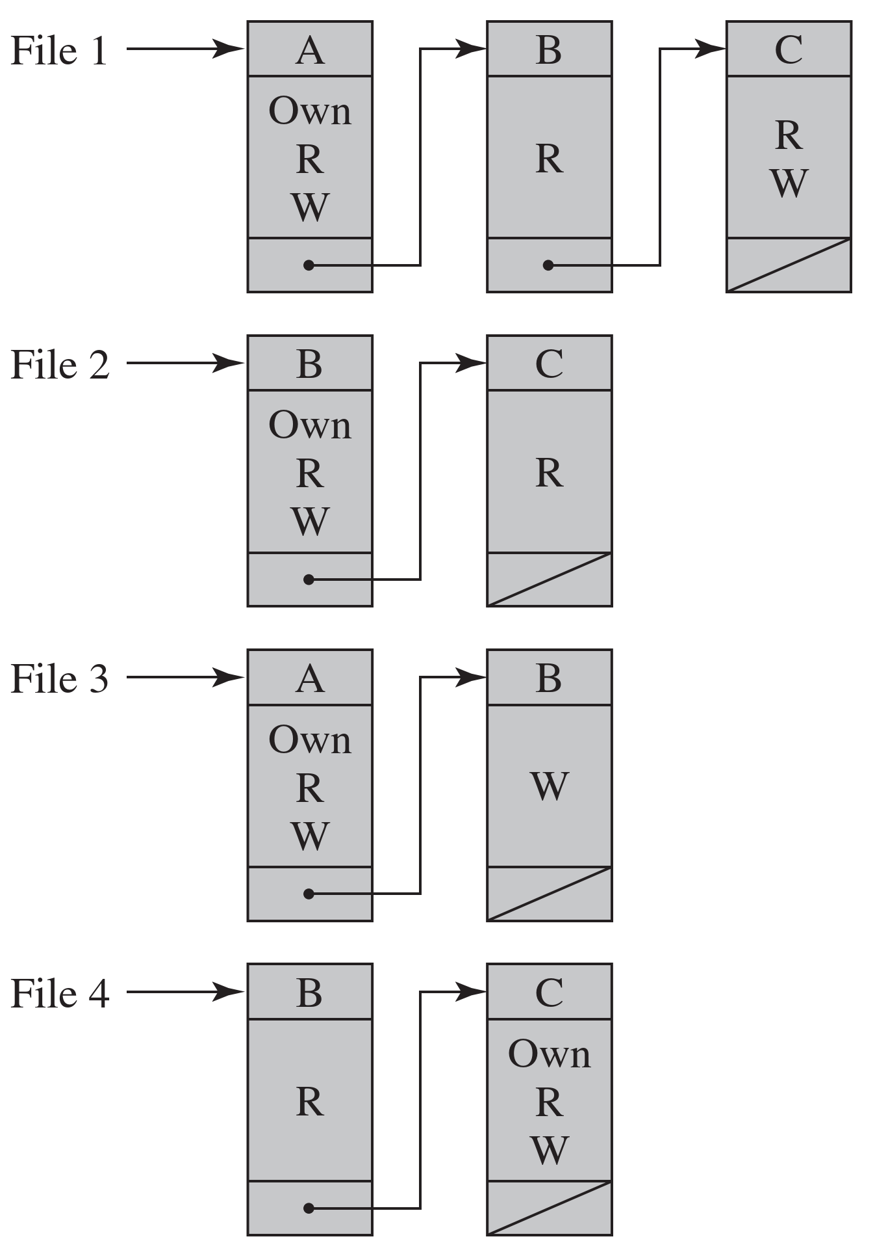
Access Control Lists (ACL)
ACLs can be stored as a linked list (arrays would be very sparse).
Notes:
Figure 4.2a, based on a figure in [SAND94], is a simple example of an access matrix. Thus, user A owns files 1 and 3 and has read and write access rights to those files. User B has read access rights to file 1, and so on.
The columns have the following headings from left to right. Subjects, Objects, file 1, Objects File 2, Objects, file 3, Objects, file 4, . The row entries are as follows. Row 1. User A, own read write, Blank, Own, read, write, Blank. Row 2. User B, Read, Own, read, write, Write, Read. Row 3. User C, Read write, Read, Blank, Own read write.

Slide 19
Capability Tickets
Rows in the access matrix represent the capability tickets of users.
A user’s ticket specifies their authorized objects and operations.
Objects
Subjects
Notes:
Figure 4.2a, based on a figure in [SAND94], is a simple example of an access matrix. Thus, user A owns files 1 and 3 and has read and write access rights to those files. User B has read access rights to file 1, and so on.
The columns have the following headings from left to right. Subjects, Objects, file 1, Objects File 2, Objects, file 3, Objects, file 4, . The row entries are as follows. Row 1. User A, own read write, Blank, Own, read, write, Blank. Row 2. User B, Read, Own, read, write, Write, Read. Row 3. User C, Read write, Read, Blank, Own read write.

Slide 20
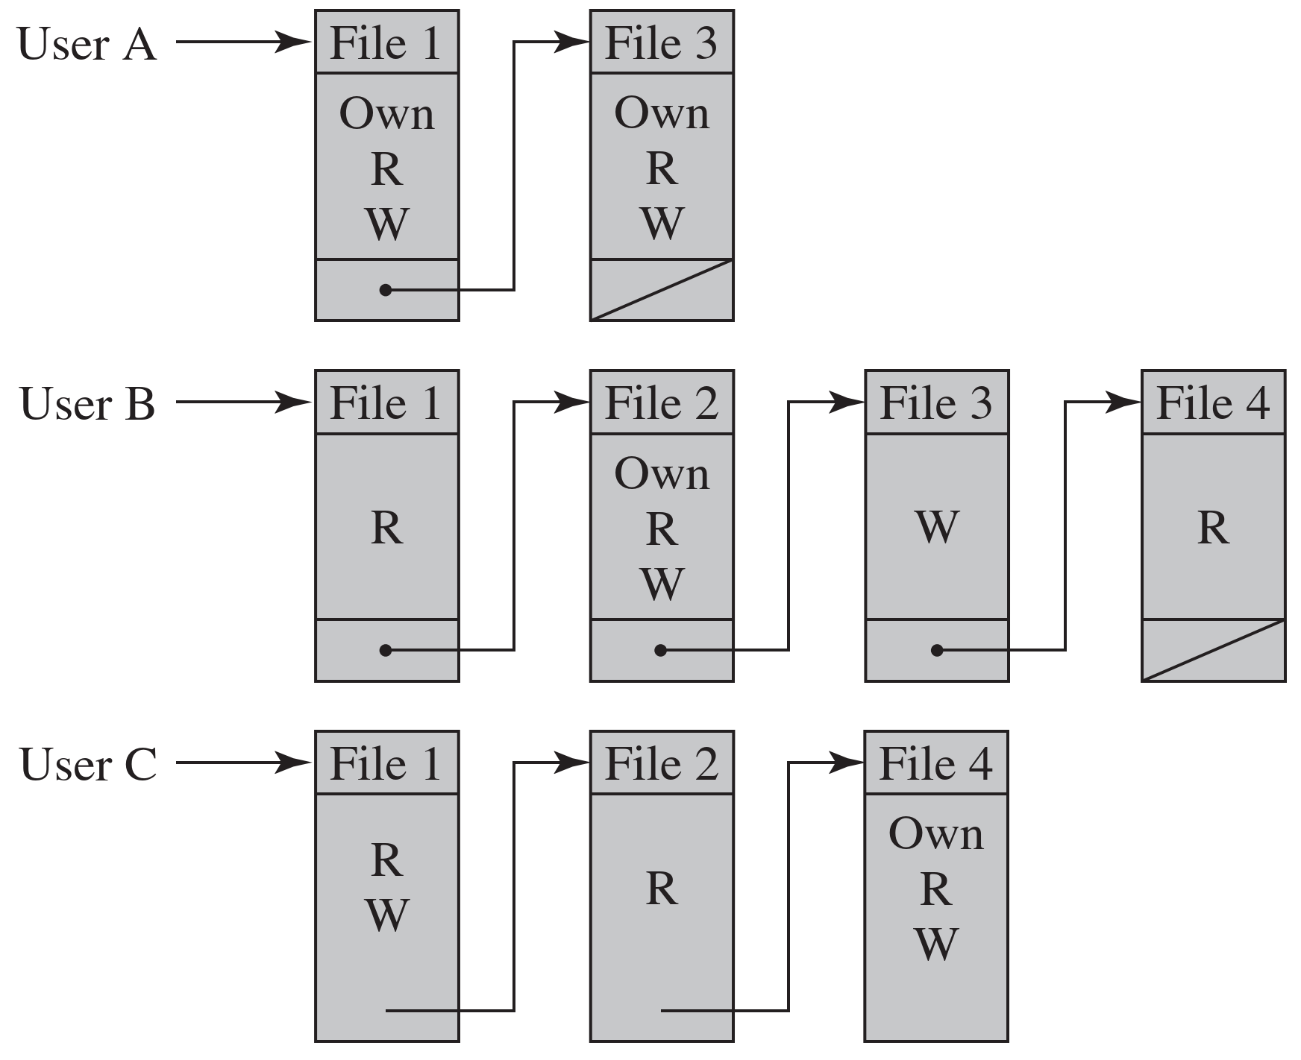
Capability Tickets
Tickets can also be maintained as linked lists.
Notes:
Figure 4.2a, based on a figure in [SAND94], is a simple example of an access matrix. Thus, user A owns files 1 and 3 and has read and write access rights to those files. User B has read access rights to file 1, and so on.
The columns have the following headings from left to right. Subjects, Objects, file 1, Objects File 2, Objects, file 3, Objects, file 4, . The row entries are as follows. Row 1. User A, own read write, Blank, Own, read, write, Blank. Row 2. User B, Read, Own, read, write, Write, Read. Row 3. User C, Read write, Read, Blank, Own read write.

Slide 21
Capability Tickets
The integrity of the ticket must be protected and guaranteed.
In particular, the ticket must be unforgeable.
One way to accomplish this is to have the OS hold all tickets on behalf of users, storing them in a protected region of memory.
Alternatively, OS can include an unforgeable token in the ticket, such as a message authentication code (MAC).
Such tickets can be handed over to users – they present it whenever accessing a resource
MAC value is verified by the resource when access is requested.
Notes:
In practice, an access matrix is usually sparse and is implemented by decomposition in one of two ways. The matrix may be decomposed by columns, yielding access control lists (ACLs); see Figure 4.2b. For each object, an ACL lists users and their permitted access rights. The ACL may contain a default, or public, entry. This allows users that are not explicitly listed as having special rights to have a default set of rights. The default set of rights should always follow the rule of least privilege or read-only access, whichever is applicable. Elements of the list may include individual users as well as groups of users.
When it is desired to determine which subjects have which access rights to a particular resource, ACLs are convenient, because each ACL provides the information for a given resource. However, this data structure is not convenient for determining the access rights available to a specific user.
Decomposition by rows yields capability tickets (Figure 4.2c). A capability ticket specifies authorized objects and operations for a particular user. Each user has a number of tickets and may be authorized to loan or give them to others. Because tickets may be dispersed around the system, they present a greater security problem than access control lists. The integrity of the ticket must be protected, and guaranteed (usually by the operating system). In particular, the ticket must be unforgeable. One way to accomplish this is to have the operating system hold all tickets on behalf of users. These tickets would have to be held in a region of memory inaccessible to users. Another alternative is to include an unforgeable token in the capability. This could be a large random password, or a cryptographic message authentication code. This value is verified by the relevant resource whenever access is requested. This form of capability ticket is appropriate for use in a distributed environment, when the security of its contents cannot be guaranteed.
The convenient and inconvenient aspects of capability tickets are the opposite of those for ACLs. It is easy to determine the set of access rights that a given user has, but more difficult to determine the list of users with specific access rights for a specific resource. The diagram is as follows. b. Access control lists for files of part a. Control lists for four files, from 1 to 4, are presented. The control lists have three parts. The control lists for file 1 has lists for user A, user B, and user C. The user A has own, read, and write, access rights. A node connects to user B list. The user B has read access right, and a node connects to user C list. The user C has read and write access rights, and the loop is closed. The file 2 has two user list. User list B has own, read, and write access rights, and a node connects the user B list connects to user C list. The iser C list has read access right, and the loop is closed. The file 3 has two user list. User list A has own, read, and write access rights, and a node connects the user A list connects to user B list. The user B list has write access right, and the loop is closed. The file 4 has two user list. User list B has read access right, and a node connects the user B list connects to user C list. The user C list has own, read, and write, access right, and the loop is closed. C. Capability lists for files of part a. The capability lists are presented for User A, user B, and user C. The user A has two capability lists. The list for file 1 has own, read, and write, access rights, and a node connects to list file 3. The list for file 3 has own, read, and write, access rights, and the loop is closed. The user B has four capability lists. The list for file 1 has read access right, and a node connects to list file 2. The file 2 has own, read, and write, access rights, and a node connects to file 3 list. The file 3 list has write access right, and a node connects to file list 4. The file 4 list has read access right, and the loop is closed. The user C has three capability lists. The file 1 list has read and write access right, and the process moves to file 2 list. The file 2 list has read access right, and the process moves to file list 4. The file list has own, read, and write, access right.

Slide 22
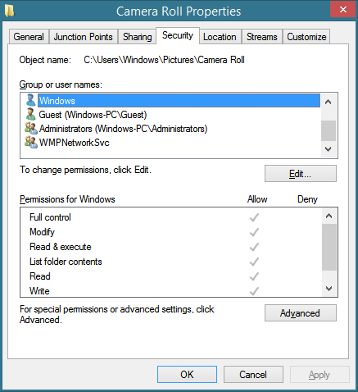
Example: Windows File/Folder ACLs
https://winaero.com/easier-way-to-set-copy-and-manage-ntfs-permissions-acls-on-files-and-folders-in-windows/

Slide 23
Role Based Access Control (RBAC)
RBAC is based on the roles that users assume in a system rather than the user’s identity.
e.g. project manager, software engineer, team leader, surveyor, IT technician, cleaner
It assigns access rights to roles instead of individual users.
In turn, users are assigned to different roles, either statically or dynamically, according to their responsibilities.

Slide 24
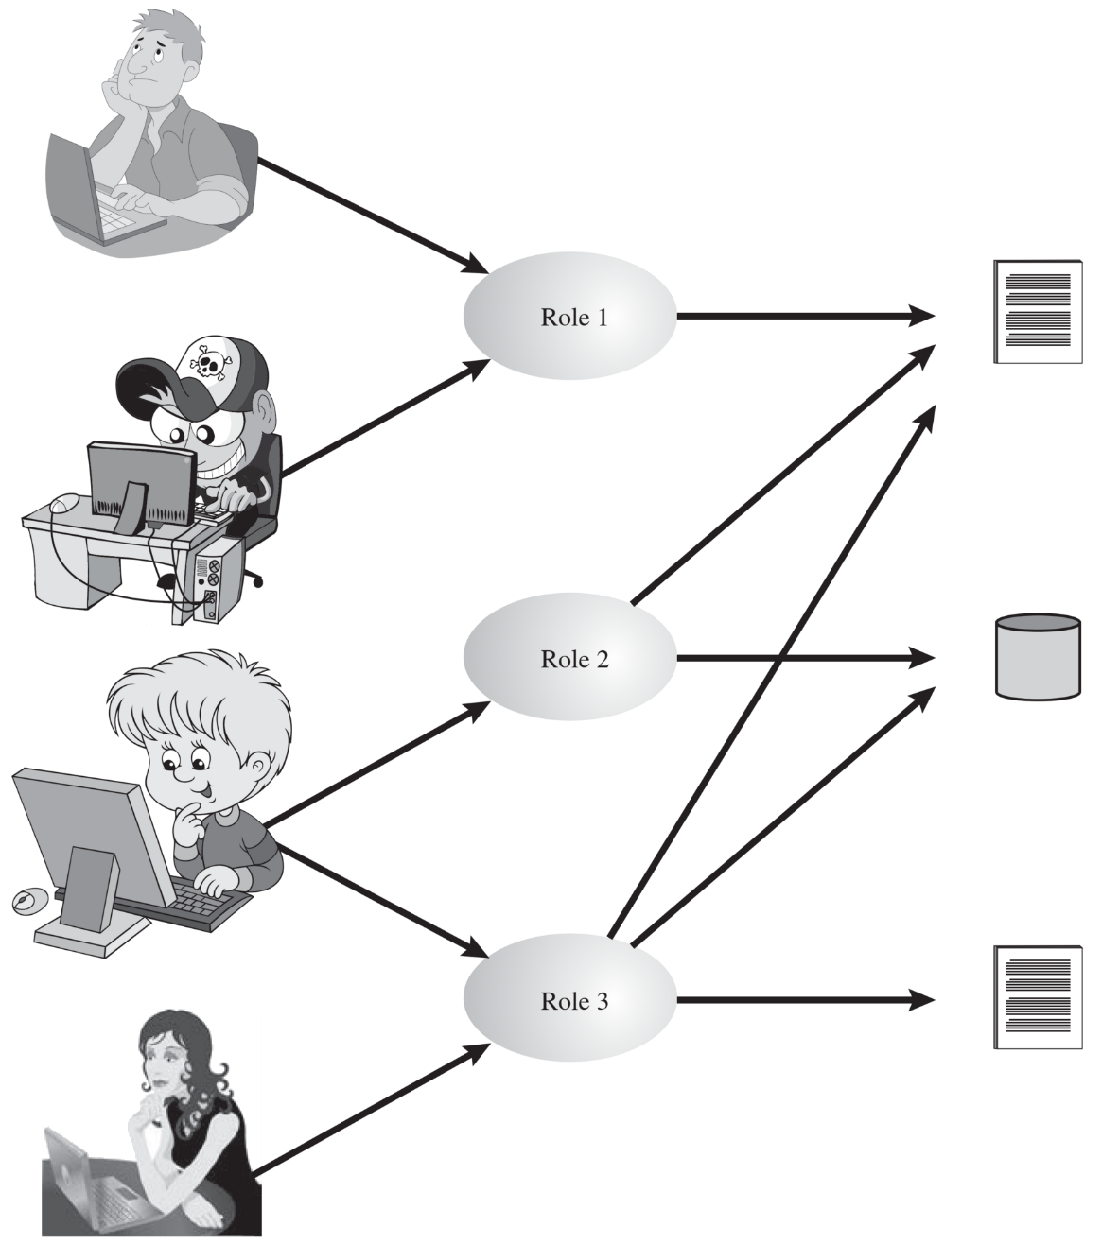
Role Based Access Control
Roles
Subjects
Resources (Objects)
Notes:
Traditional DAC systems define the access rights of individual users and groups of users. In contrast, RBAC is based on the roles that users assume in a system rather than the user’s identity. Typically, RBAC models define a role as a job function within an organization. RBAC systems assign access rights to roles instead of individual users. In turn, users are assigned to different roles, either statically or dynamically, according to their responsibilities.
RBAC now enjoys widespread commercial use and remains an area of active research. The National Institute of Standards and Technology (NIST) has issued a standard, FIPS PUB 140-3, (Security Requirements for Cryptographic Modules September 2009), that requires support for access control and administration through roles.
The relationship of users to roles is many to many, as is the relationship of roles to resources, or system objects (Figure 4.6). The set of users changes, in some environments frequently, and the assignment of a user to one or more roles may also be dynamic. The set of roles in the system in most environments is relatively static, with only occasional additions or deletions. Each role will have specific access rights to one or more resources. The set of resources and the specific access rights associated with a particular role are also likely to change infrequently.
The relationship of users to roles is many to many, as is the relationship of roles to resources, or system objects. The set of users changes, in some environments frequently, and the assignment of a user to one or more roles may also be dynamic. Each role will have specific access rights to one or more resources. The set of resources and the specific access rights associated with a particular role are also likely to change infrequently.

Slide 25
Role Based Access Control
Roles
Subjects
Resources (Objects)
The relationship of users to roles is many to many, as is the relationship of roles to objects.
Notes:
Traditional DAC systems define the access rights of individual users and groups of users. In contrast, RBAC is based on the roles that users assume in a system rather than the user’s identity. Typically, RBAC models define a role as a job function within an organization. RBAC systems assign access rights to roles instead of individual users. In turn, users are assigned to different roles, either statically or dynamically, according to their responsibilities.
RBAC now enjoys widespread commercial use and remains an area of active research. The National Institute of Standards and Technology (NIST) has issued a standard, FIPS PUB 140-3, (Security Requirements for Cryptographic Modules September 2009), that requires support for access control and administration through roles.
The relationship of users to roles is many to many, as is the relationship of roles to resources, or system objects (Figure 4.6). The set of users changes, in some environments frequently, and the assignment of a user to one or more roles may also be dynamic. The set of roles in the system in most environments is relatively static, with only occasional additions or deletions. Each role will have specific access rights to one or more resources. The set of resources and the specific access rights associated with a particular role are also likely to change infrequently.
The relationship of users to roles is many to many, as is the relationship of roles to resources, or system objects. The set of users changes, in some environments frequently, and the assignment of a user to one or more roles may also be dynamic. Each role will have specific access rights to one or more resources. The set of resources and the specific access rights associated with a particular role are also likely to change infrequently.

Slide 26
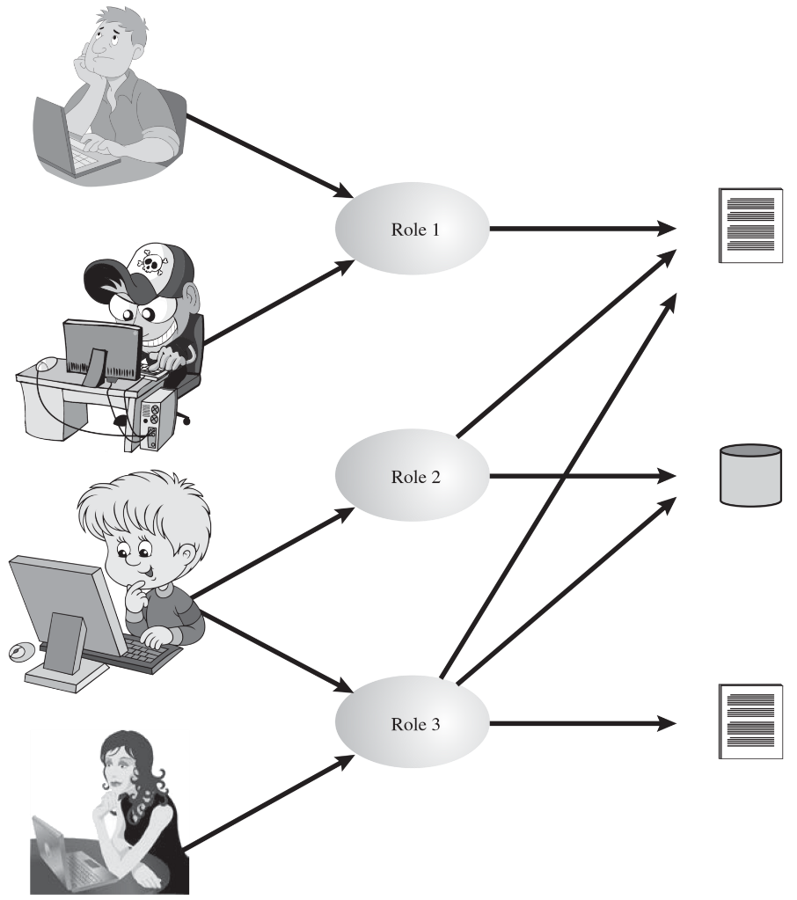
Role Based Access Control
Subjects
Roles
Resources
The set of users could change frequently.
Assignment of a user to one or more roles is also dynamic.
Notes:
Traditional DAC systems define the access rights of individual users and groups of users. In contrast, RBAC is based on the roles that users assume in a system rather than the user’s identity. Typically, RBAC models define a role as a job function within an organization. RBAC systems assign access rights to roles instead of individual users. In turn, users are assigned to different roles, either statically or dynamically, according to their responsibilities.
RBAC now enjoys widespread commercial use and remains an area of active research. The National Institute of Standards and Technology (NIST) has issued a standard, FIPS PUB 140-3, (Security Requirements for Cryptographic Modules September 2009), that requires support for access control and administration through roles.
The relationship of users to roles is many to many, as is the relationship of roles to resources, or system objects (Figure 4.6). The set of users changes, in some environments frequently, and the assignment of a user to one or more roles may also be dynamic. The set of roles in the system in most environments is relatively static, with only occasional additions or deletions. Each role will have specific access rights to one or more resources. The set of resources and the specific access rights associated with a particular role are also likely to change infrequently.
The relationship of users to roles is many to many, as is the relationship of roles to resources, or system objects. The set of users changes, in some environments frequently, and the assignment of a user to one or more roles may also be dynamic. Each role will have specific access rights to one or more resources. The set of resources and the specific access rights associated with a particular role are also likely to change infrequently.

Slide 27
Role Based Access Control
Subjects
Roles
Resources
The set of roles in the system in mostly static, with occasional updates.
The set of resources and the specific access rights associated with a particular role also change infrequently.
Notes:
Traditional DAC systems define the access rights of individual users and groups of users. In contrast, RBAC is based on the roles that users assume in a system rather than the user’s identity. Typically, RBAC models define a role as a job function within an organization. RBAC systems assign access rights to roles instead of individual users. In turn, users are assigned to different roles, either statically or dynamically, according to their responsibilities.
RBAC now enjoys widespread commercial use and remains an area of active research. The National Institute of Standards and Technology (NIST) has issued a standard, FIPS PUB 140-3, (Security Requirements for Cryptographic Modules September 2009), that requires support for access control and administration through roles.
The relationship of users to roles is many to many, as is the relationship of roles to resources, or system objects (Figure 4.6). The set of users changes, in some environments frequently, and the assignment of a user to one or more roles may also be dynamic. The set of roles in the system in most environments is relatively static, with only occasional additions or deletions. Each role will have specific access rights to one or more resources. The set of resources and the specific access rights associated with a particular role are also likely to change infrequently.
The relationship of users to roles is many to many, as is the relationship of roles to resources, or system objects. The set of users changes, in some environments frequently, and the assignment of a user to one or more roles may also be dynamic. Each role will have specific access rights to one or more resources. The set of resources and the specific access rights associated with a particular role are also likely to change infrequently.

Slide 28
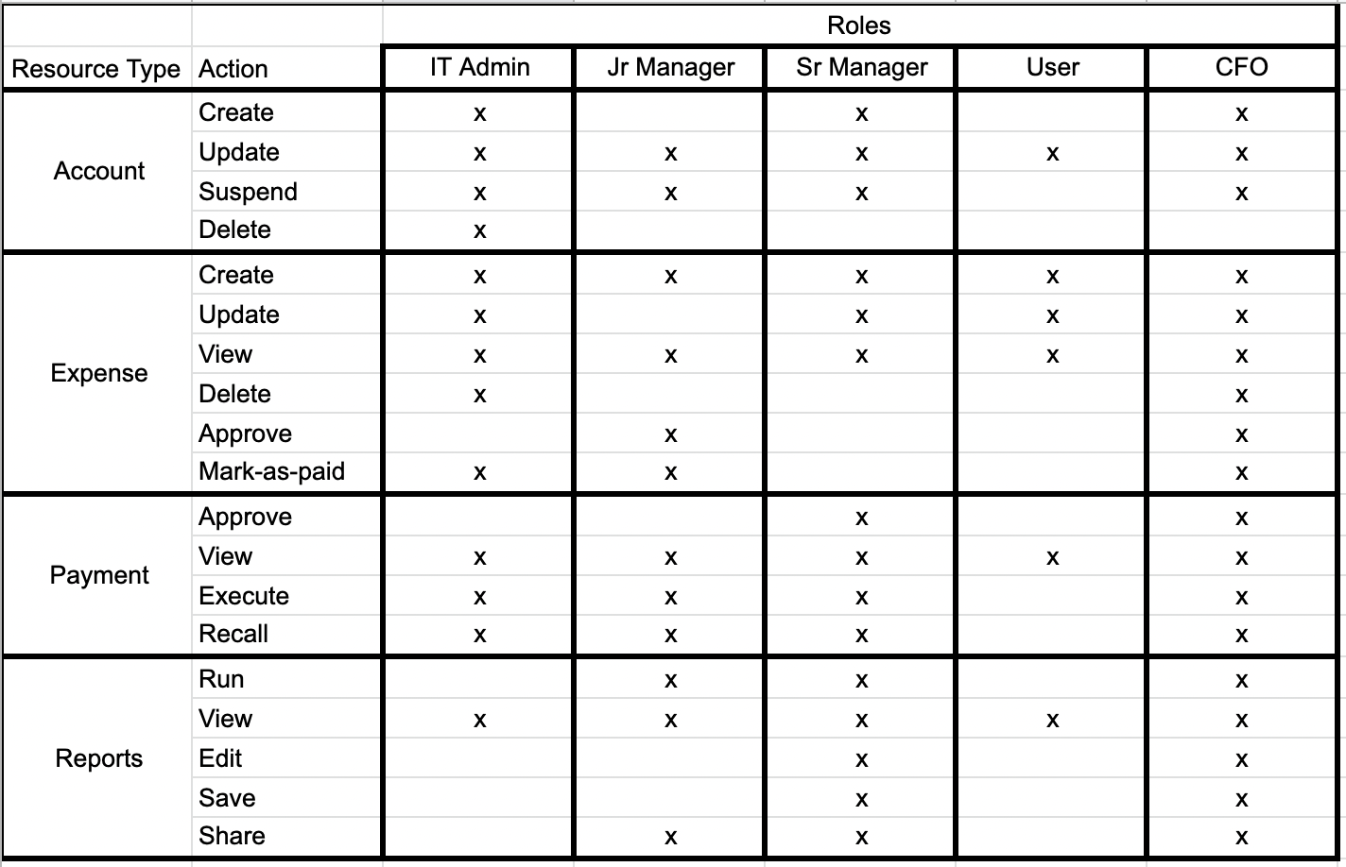
Example: Role privilege matrix
https://www.cerbos.dev/blog/mapping-business-requirements-to-authorization-policy

Slide 29
Example: Role assignments
 | IT Admin | Junior Manager | User | Accounts officer | CFO
Ali | x
Hania |  | x
Faiqa | x |  | x
Zaheer |  |  |  |  | x
Usman |  | x |  | x

Slide 30
RBAC Hierarchies
Its possible to design RBAC in a hierarchical fashion, reflecting the hierarchical structure of organization.
Typically, job functions with greater responsibility have greater authority to access resources. A subordinate job function may have a subset of the access rights of the superior job function.
Role hierarchies make use of the inheritance to enable one role to implicitly include access rights associated with a subordinate role.

Slide 31
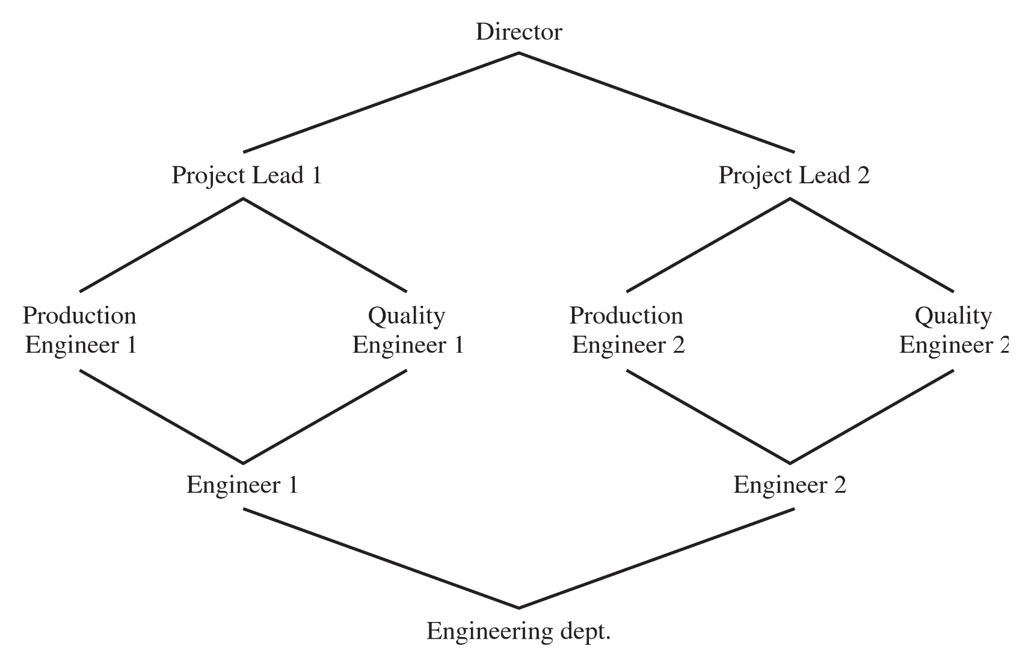
RBAC Hierarchies

Slide 32
DAC vs RBAC
“It’s easy to confuse DAC and RBAC because they can both use groups to organize users into manageable units, but they differ in their deployment and use. In the DAC model, objects have owners, and the owner determines who has access. […] In a strict RBAC model, administrators do not assign privileges to users directly but only grant privileges by adding user accounts to roles or groups.”
CISSP Study Guide

Slide 33
Mandatory Access Control (MAC)
MAC model evolved out of requirements of government and military applications
It applies labels (or classification) to objects
e.g. confidential, top secret, secret, public, etc.
Similarly, subjects are given a security clearance
MAC controls access based on comparing security classifications with security clearances
e.g. someone with secret clearance can’t access top secret data
The system owner/administrator manage access rights themselves, individual users have no control

Slide 34
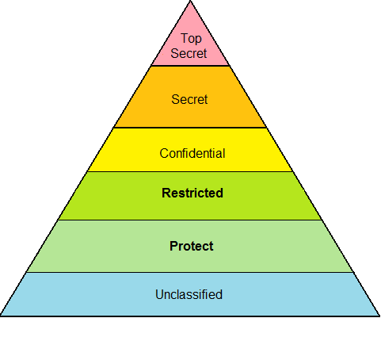
Classifications: UK govt example
Classifications are hierarchical. So, someone with confidential clearance *could* have access to resources that are classified confidential or below (but subject to other constraints).
Somone with protected clearance can NOT have access to restricted (or higher classification) resources.
https://en.wikipedia.org/wiki/Government_Security_Classifications_Policy

Slide 35
MAC Rules
When the system makes a decision about fulfilling an access request, it is based on the clearance of the subject, the classification of the object, and the security policy of the system.
This means that even if a user has the right clearance to read a file, specific policies (e.g., requiring “need to know”) could still prevent access to it.
Each object is assigned a security label containing
classification: sensitivity level
category: the sub-compartment of information

Slide 36
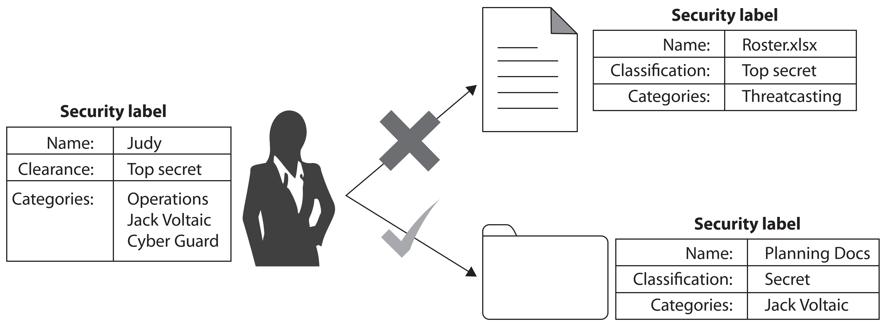
MAC example
Judy has Top secret clearance. She can access objects classified as Top secret or lower but ONLY if the object’s category belongs to set of categories in Judy’s security label.

Slide 37
Attribute-Based Access Control
An ABAC model can define authorizations that express conditions on properties of object, subject or environment.
Attributes are characteristics that define specific aspects of the subject, object, environment conditions, and/or requested operations that are predefined and preassigned by an authority.
Notes:
A relatively recent development in access control technology is the attribute-based access control (ABAC) model. An ABAC model can define authorizations that express conditions on properties of both the resource and the subject. For example, consider a configuration in which each resource has an attribute that identifies the subject that created the resource. Then, a single access rule can specify the ownership privilege for all the creators of every resource. The strength of the ABAC approach is its flexibility and expressive power. [PLAT13] points out that the main obstacle to its adoption in real systems has been concern about the performance impact of evaluating predicates on both resource and user properties for each access. However, for applications such as cooperating Web services and cloud computing, this increased performance cost is less noticeable because there is already a relatively high performance cost for each access. Thus, Web services have been pioneering technologies for implementing ABAC models, especially through the introduction of the eXtensible Access Control Markup Language (XAMCL) [BEUC13], and there is considerable interest in applying the ABAC model to cloud services [IQBA12, YANG12].
There are three key elements to an ABAC model: attributes, which are defined for entities in a configuration; a policy model, which defines the ABAC policies; and the architecture model, which applies to policies that enforce access control. We examine these elements in turn.

Slide 38
A B A C Model: Terms
subject | an active entity (user, process, device) that causes information flow or change in system state
object | a passive entity containing or receiving information
environment | the operational, technical, or situational context in which the information access occurs
Notes:
Attributes are characteristics that define specific aspects of the subject, object, environment conditions, and/or requested operations that are predefined and preassigned by an authority. Attributes contain information that indicates the class of information given by the attribute, a name, and a value (e.g., Class=HospitalRecordsAccess, Name=PatientInformationAccess, Value=MFBusinessHoursOnly).
The following are the three types of attributes in the ABAC model:
• Subject attributes: A subject is an active entity (e.g., a user, an application, a process, or a device) that causes information to flow among objects or changes the system state. Each subject has associated attributes that define the identity and characteristics of the subject. Such attributes may include the subject’s identifier, name, organization, job title, and so on. A subject’s role can also be viewed as an attribute.
• Object attributes: An object, also referred to as a resource , is a passive (in the context of the given request) information system-related entity (e.g., devices, files, records, tables, processes, programs, networks, domains) containing or receiving information. As with subjects, objects have attributes that can be leveraged to make access control decisions. A Microsoft Word document, for example, may have attributes such as title, subject, date, and author. Object attributes can often be extracted from the metadata of the object. In particular, a variety of Web service metadata attributes may be relevant for access control purposes, such as ownership, service taxonomy, or even Quality of Service (QoS) attributes.
• Environment attributes: These attributes have so far been largely ignored in most access control policies. They describe the operational, technical, and even situational environment or context in which the information access occurs. For example, attributes, such as current date and time, the current virus/hacker activities, and the network’s security level (e.g., Internet vs. intranet), are not associated with a particular subject nor a resource, but may nonetheless be relevant in applying an access control policy.

Slide 39
A B A C Model: Attributes
Attribute examples
Subject | Object | Environment
id name date of birth organization job title training record location experience duration role | type date created date modified title author size state (e.g. on, off, asleep) ownership | date & time temperature network security level (Internet or intranet) current attack situation

Slide 40
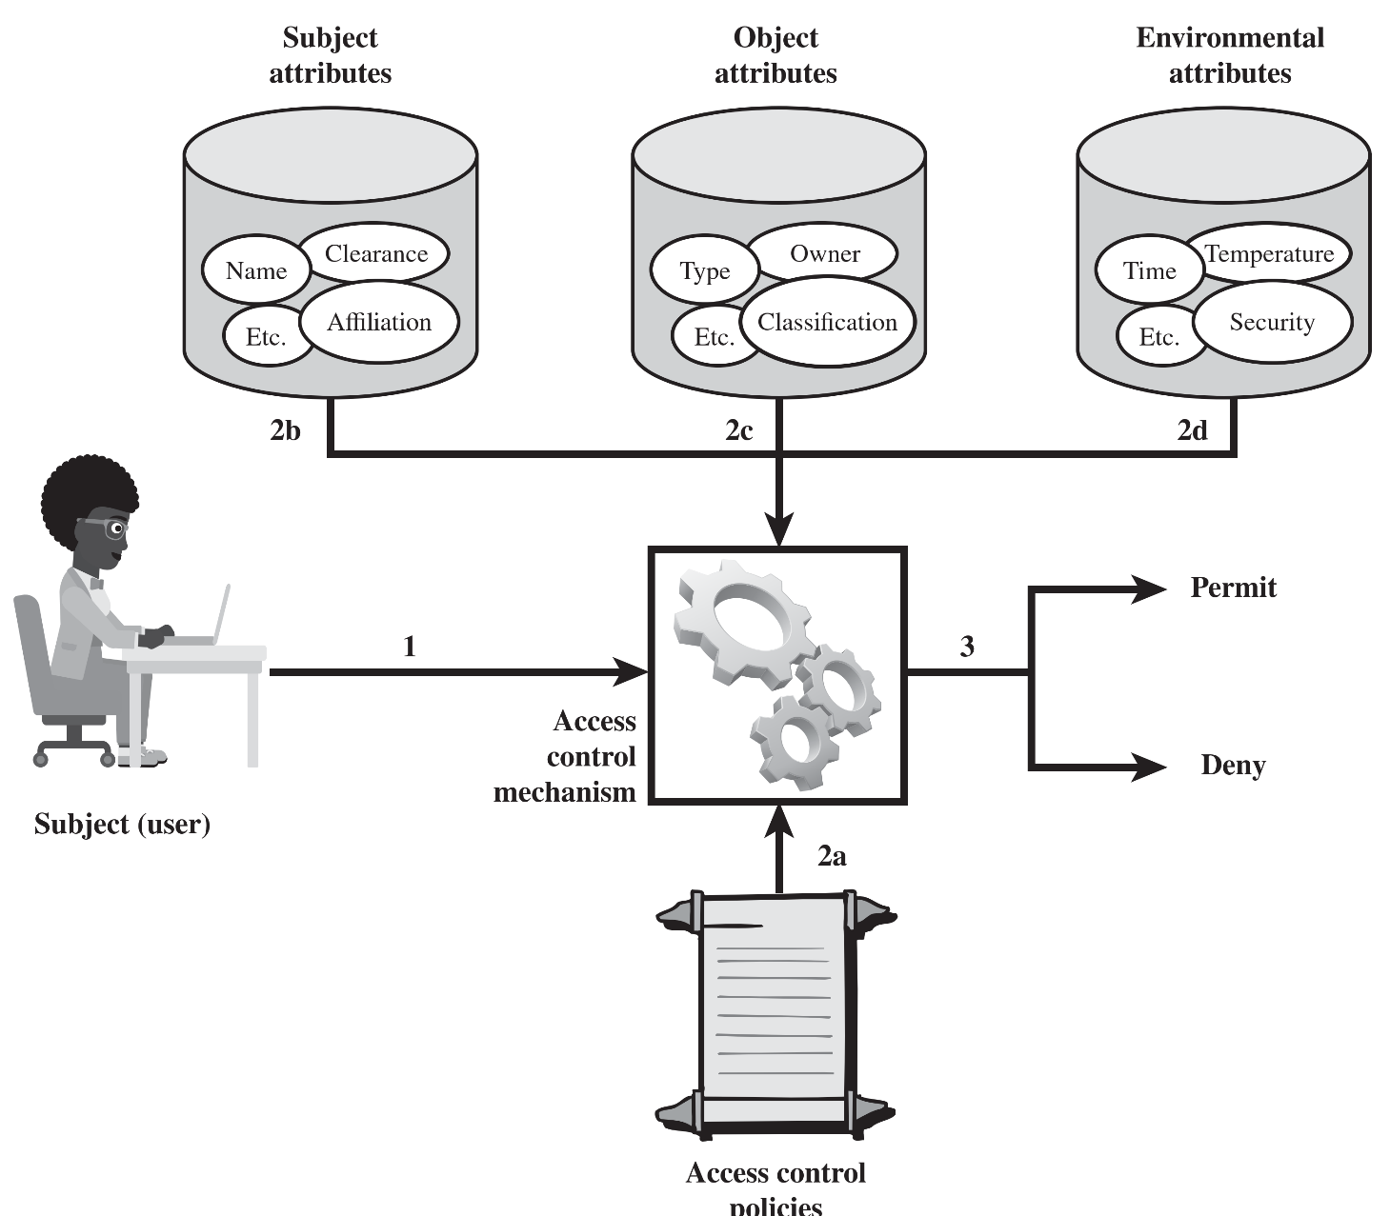
A B A C Model
Notes:
Figure 4.10 illustrates in a logical architecture the essential components of an ABAC system. An access by a subject to an object proceeds according to the following steps:
1. A subject requests access to an object. This request is routed to an access control mechanism.
2. The access control mechanism is governed by a set of rules (2a) that are defined by a preconfigured access control policy. Based on these rules, the access control mechanism assesses the attributes of the subject (2b), object (2c), and current environmental conditions (2d) to determine authorization.
3. The access control mechanism grants the subject access to the object if access is authorized and denies access if it is not authorized.
It is clear from the logical architecture that there are four independent sources of information used for the access control decision. The system designer can decide which attributes are important for access control with respect to subjects, objects, and environmental conditions. The system designer or other authority can then define access control policies, in the form of rules, for any desired combination of attributes of subject, object, and environmental conditions. It should be evident that this approach is very powerful and flexible. However, the cost, both in terms of the complexity of the design and implementation and in terms of the performance impact, is likely to exceed that of other access control approaches. This is a tradeoff that the system authority must make.
The diagram is as follows. 1. The subject or user intiates command to the access control mechanism. 2 a. Access control mechanism acts as per predetermined access control policies. Data from the following is provided to the access control mechanism. 2 b. Subject attributes like name, clearance, affiliation, et cetra. 2 c. Object attributes, owner, type, classification, et cetera. 2 d. Environmental attributes, time, temperature, security, et cetera. 3. Permit or deny.

Slide 41
A B A C Policy Rules
ABAC controls access to objects by evaluating rules against the attributes of entities, operations, and the environment relevant to a request
Access to resource will be allowed as per the access control rule defining the allowable operations for subject-object attribute combinations in a given environment
A policy is a set of rules and relationships that govern allowable behavior within an organization, based on the privileges of subjects and how resources or objects are to be protected under which environment conditions
Privileges represent the authorized behavior of a subject and are defined by an authority and embodied in a policy
Notes:
ABAC is a logical access control model that is distinguishable because it controls access to objects by evaluating rules against the attributes of entities (subject and object), operations, and the environment relevant to a request. ABAC relies upon the evaluation of attributes of the subject, attributes of the object, and a formal relationship or access control rule defining the allowable operations for subject-object attribute combinations in a given environment. All ABAC solutions contain these basic core capabilities to evaluate attributes and enforce rules or relationships between those attributes. ABAC systems are capable of enforcing DAC, RBAC, and MAC concepts. ABAC enables fine-grained access control, which allows for a higher number of discrete inputs into an access control decision, providing a bigger set of possible combinations of those variables to reflect a larger and more definitive set of possible rules, policies, or restrictions on access. Thus, ABAC allows an unlimited number of attributes to be combined to satisfy any access control rule. Moreover, ABAC systems can be implemented to satisfy a wide array of requirements from basic access control lists through advanced expressive policy models that fully leverage the flexibility of ABAC.

Slide 42
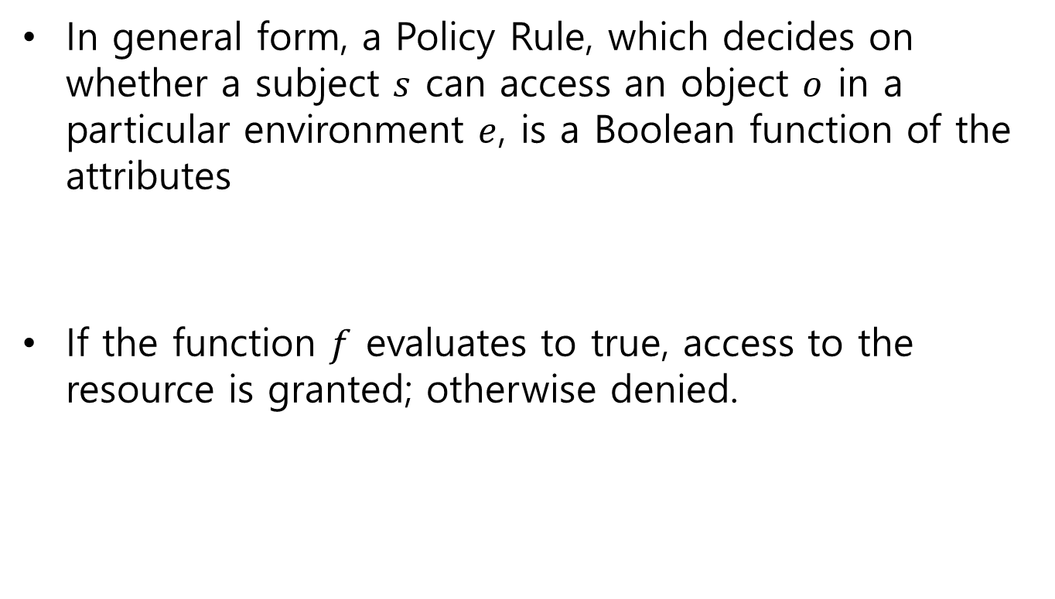
A B A C Policy Rules
In general form, a Policy Rule, which decides on whether a subject $s$ can access an object $o$ in a particular environment $e$, is a Boolean function of the attributes
If the function $f$ evaluates to true, access to the resource is granted; otherwise denied.
Notes:
A policy is a set of rules and relationships that govern allowable behavior within an organization, based on the privileges of subjects and how resources or objects are to be protected under which environment conditions. In turn, privileges represent the authorized behavior of a subject; they are defined by an authority and embodied in a policy. Other terms that are commonly used instead of privileges are rights, authorizations, and entitlements . Policy is typically written from the perspective of the object that needs protecting and the privileges available to subjects.

Slide 43
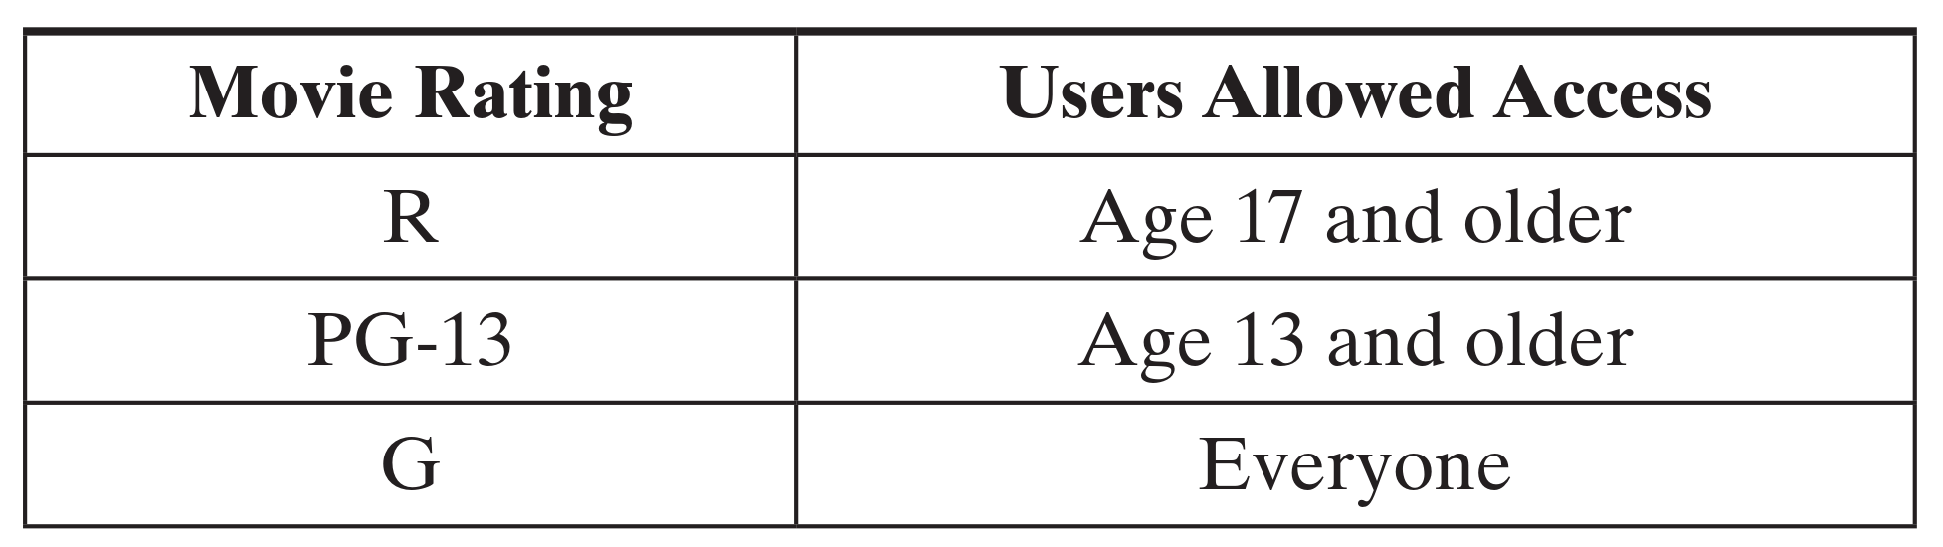
Case Study: Movie Streaming
An OTT platform streams movies to users for a flat monthly fee.
The store enforces the following access control policy

Slide 44
Case Study: Movie Streaming
In an RBAC model, every user would be assigned one of three roles: Adult, Juvenile, or Child, possibly during registration.
Both the user-to-role and permission-to-role assignments are manual administrative tasks.
Adult
R movies
User A
Juvenile
PG-13 movies
User B
Child
G movies

Slide 45
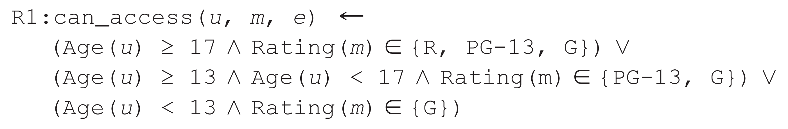
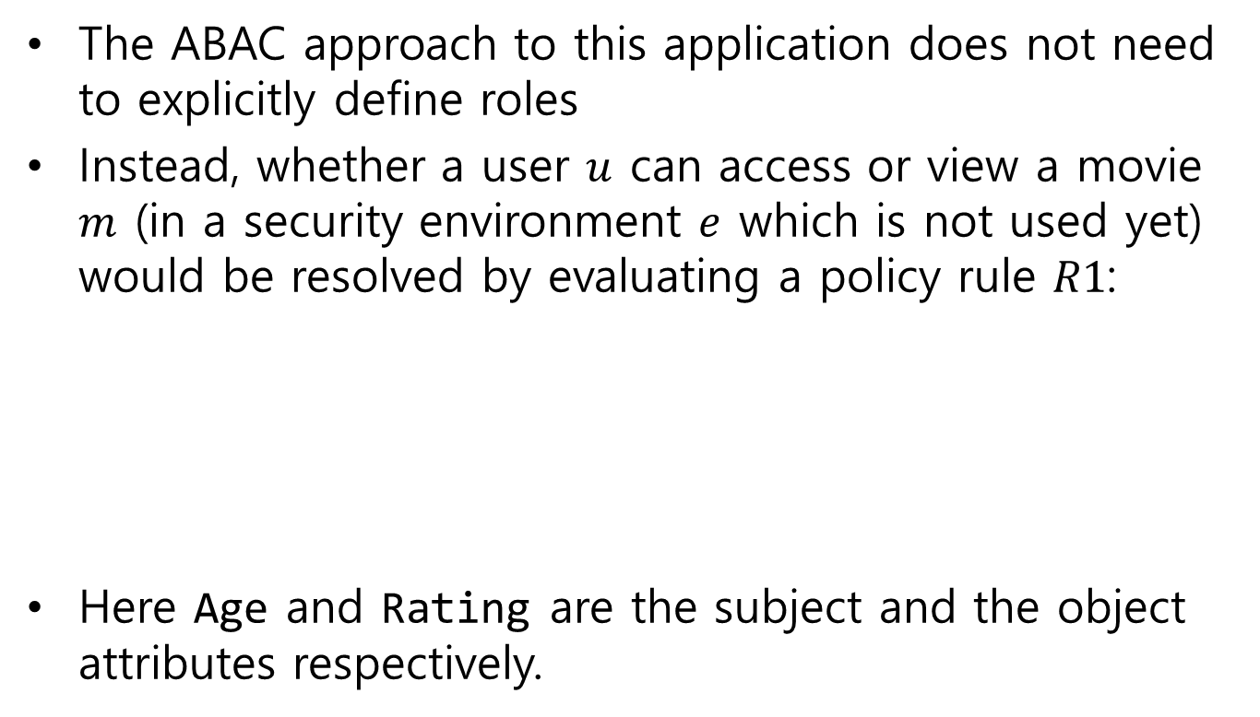
Case Study: Movie Streaming
The ABAC approach to this application does not need to explicitly define roles
Instead, whether a user $u$ can access or view a movie $m$ (in a security environment $e$ which is not used yet) would be resolved by evaluating a policy rule $R1$:
Here Age and Rating are the subject and the object attributes respectively.
∧ = logic AND, ∨ = logic OR

Slide 46
Case Study: Movie Streaming
Further, now suppose that movies are classified as either New Release or Old Release, based on release date.
Users are classified as Premium User or Regular User, based on the fee they pay.
The company would like to enforce a policy: Only premium users can view new movies.

Slide 47
Case Study: Movie Streaming
To incorporate these new requirements in the RBAC model, we would have to:
double the number of roles, to distinguish each user by age and fee (Adult_Premium, Adult_Regular, Child_Premium, …)
double the categories of movies (G_New, G_Old, PG13_New, PG13_Old, …)
And so the number of role-to-object permissions will increase four times.

Slide 48
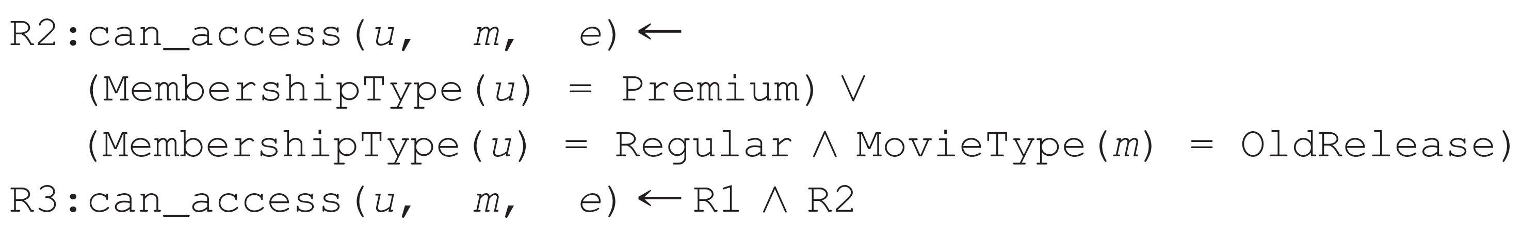
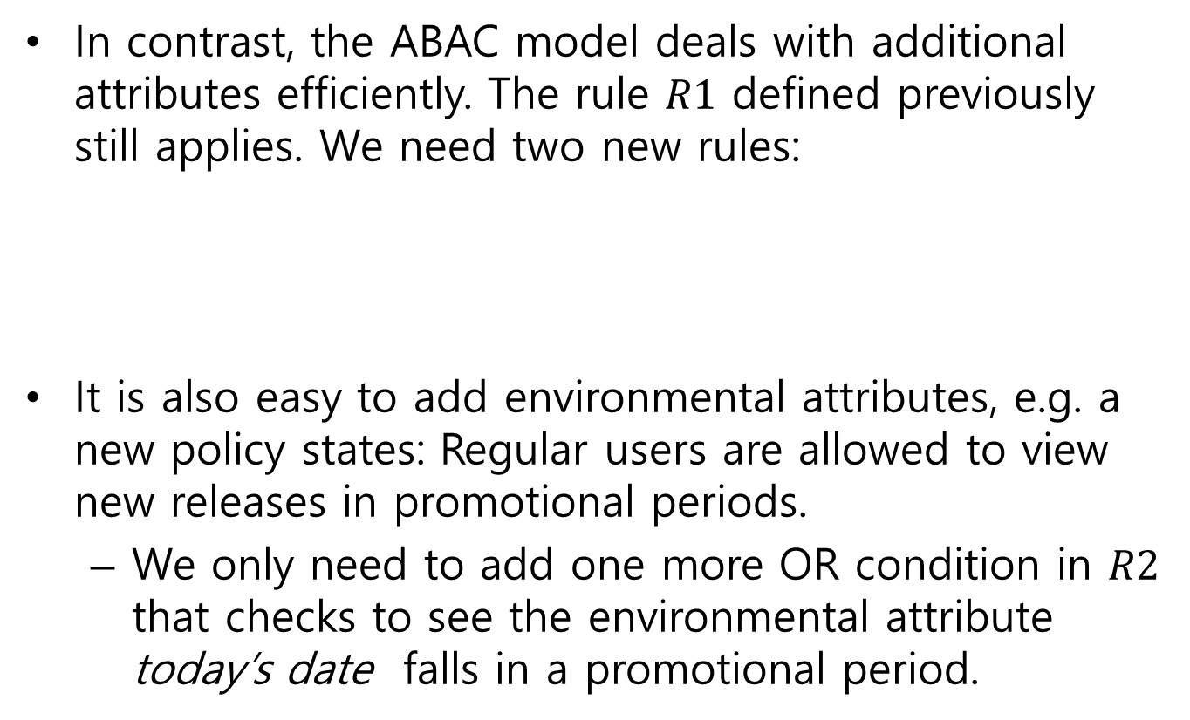
Case Study: Movie Streaming
In contrast, the ABAC model deals with additional attributes efficiently. The rule $R1$ defined previously still applies. We need two new rules:
It is also easy to add environmental attributes, e.g. a new policy states: Regular users are allowed to view new releases in promotional periods.
We only need to add one more OR condition in $R2$ that checks to see the environmental attribute today’s date falls in a promotional period.

Slide 49
ABAC strengths
Strength of ABAC model is its flexibility and expressive power
ABAC is actually a more generalized model. It is capable of enforcing DAC, RBAC, and MAC concepts.
It allows an unlimited number of attributes to be combined to satisfy any access control rule.
ABAC model eliminates the definition and management of static roles, hence eliminating the need for the administrative tasks for user-to-role assignment and permission-to-role assignment.

Slide 50
Reference
Stallings SPP chap 4
All-in-one CISSP Exam Guide, by Harris Maymi, chap 17

